Slide 1
ELECTRICAL SCIENCE-1 (15B11EC111) UNIT-4 Lecture-1

Slide 2
Chapter4 Steady State Analysis of Sinusoid

Slide 3
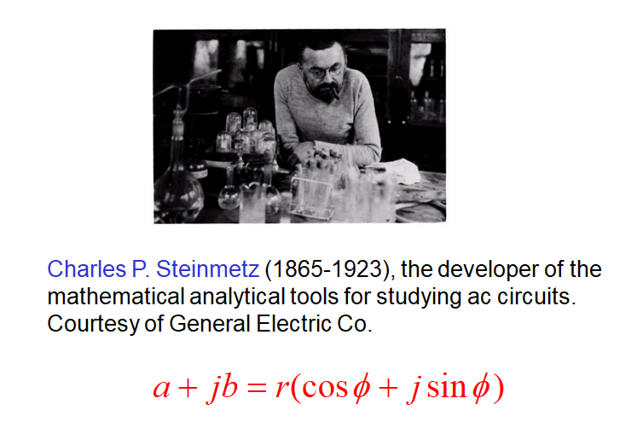

Slide 4
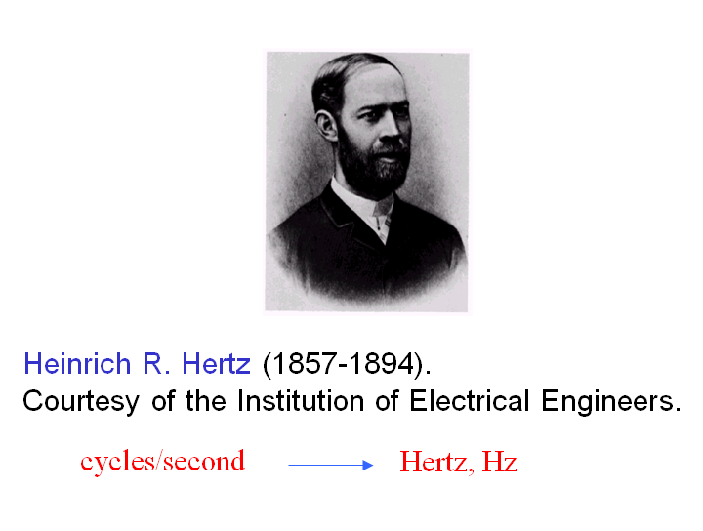

Slide 5
Topics to be covered
DC and AC Currents.
A Sinusoid.
❑ Some Definitions.
❑ Phase Difference.
❑ Physical Model for a Sinusoid.
Average of a sine wave.
RMS or Effective Value.
Concept of Phasors.
❑ Operations on Phasors.
Additions of Phasors
Using Complex Numbers.
Power and Power Factor.
Purely Resistive Circuit.
Purely Inductive Circuit.
❑ Inductive Reactance.
Purely Capacitive Circuit.
❑ Capacitive Reactance
‹#›

Slide 6
DC and AC Currents
Difference between
In dc circuits, when a current of 3 A adds to another current of 4 A, the net current is always 7 A.
However, an ac current of 3 A when added to another ac current of 4 A can result anything between 1 A and 7 A, depending upon their relative phase.
It is similar to adding a force of 3 N to another force of 4 N. The result is not necessarily a force of 7 N. It be anything between 1 N to 7 N, depending on their relative directions. These are added vectorially.
‹#›

Slide 7
Does it mean that KCL does not apply to AC Circuits ?
Ans. :Yes, it does apply. However, the ac currents are added in a Phasor Diagram.
I = I₁ + I ₂
‹#›

Slide 8
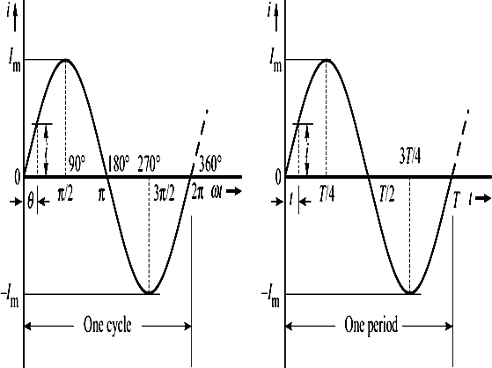
A Sinusoid
(a) Current i versus angle ωt. (b) Current i versus time t.
i = I_{m} sinωt
Next
‹#›

Slide 9
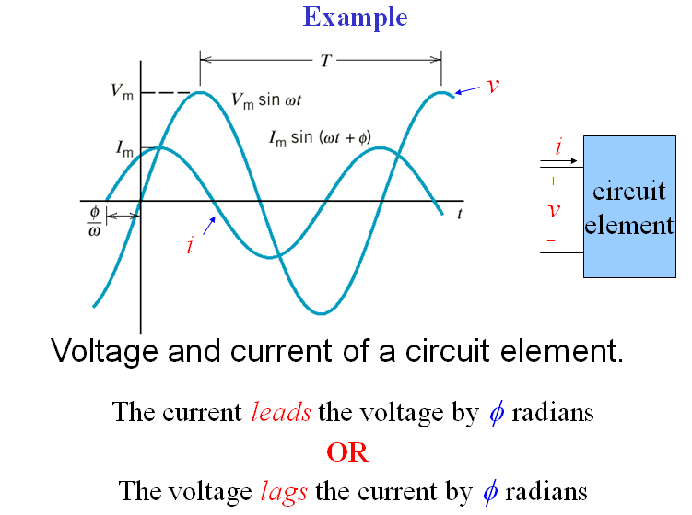

Slide 10
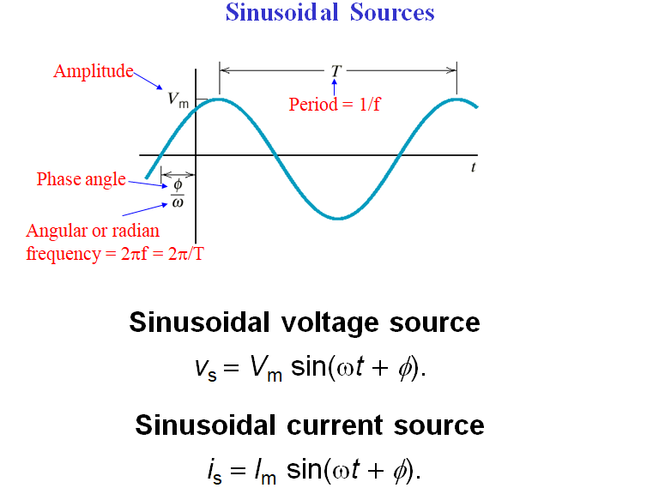

Slide 11
Some Definitions
Amplitude (or peak value) : It is the maximum value, positive or negative, of an alternating quantity.
Instantaneous Value : It is the value of the quantity at any instant.
Time period (T) : It is the duration of one complete cycle.
Frequency (f) : It is the number of cycles that occurs in one second.
f = ¹
T
Next

Slide 12
Angular Frequency : Angular frequency, denoted as ω, is equal to the number of radians covered in one second. Its unit is rad/s. Since one cycle covers 2π radians and there are f cycles in one second, the angular frequency is given as
_{ω =} 2π
ω = 2πf
or
T
Next

Slide 13
Phase : It is the fraction of the time-period or cycle that has elapsed since it last passed from the chosen zero position or origin. The phase at time t from the chosen origin is given by t/T.
Phase angle : It is the equivalent of phase expressed in radians or degrees. It is denoted as θ. Thus, phase angle, θ = 2πt/T.
Phase difference : It is the angular displacement between two alternating quantities.
Next
‹#›

Slide 14
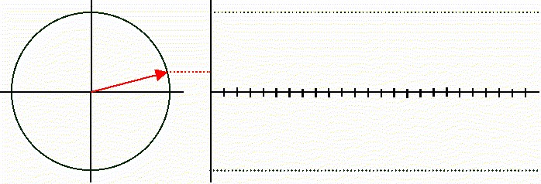
A rotating bar generates a sinusoidal wave.
Next
‹#›

Slide 15
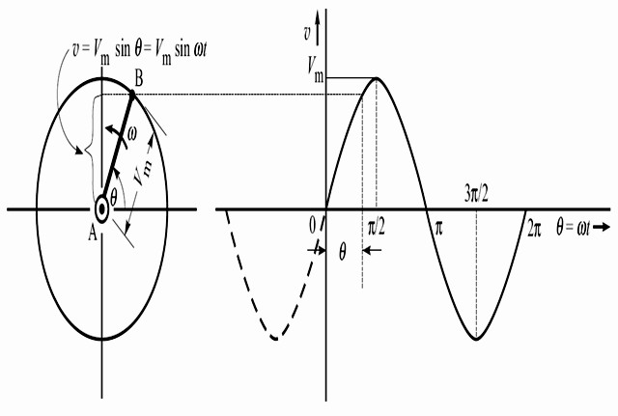
Physical Model for a Sinusoid
(a) A rotating crank. (b) Sinusoidal waveform.
The vertical projection of the rotating crank is its length times the sine of the angle θ.
Next
‹#›

Slide 16
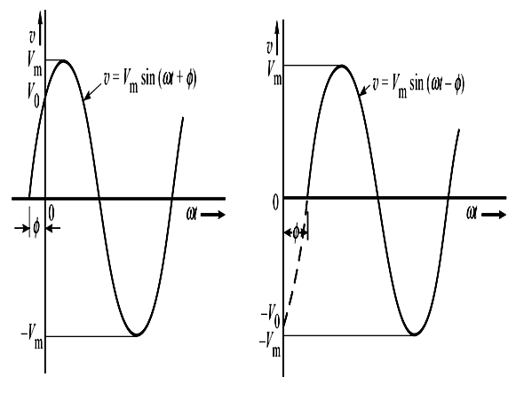
Phase Difference
(a) Displacement byφ to the left
(b) Displacement by φ
to the right
It has become normal practice in electrical engineering to express ωt in radians and the angle in degrees.

Slide 17
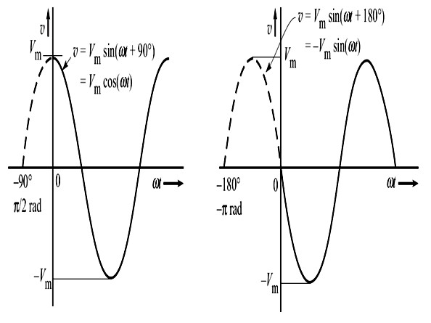
(c) Displacement
by 90° to the left.
(d) Displacement
by 180°.
Note that the resulting position of the waveform is the same whether the phase shift is 180° (π rad) to the left, or 180° to the right.
Next

Slide 18
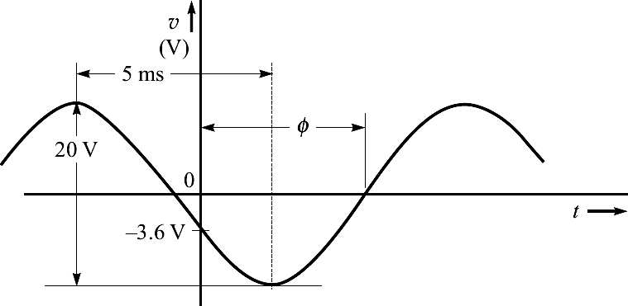
Example 1
A sinusoidal voltage is 20 V peak-to-peak, has a time of 5 ms between consecutive peak and trough, and at t = 0 is -3.6 V and decreasing. Find the equation for the instantaneous value of the voltage, and the value
NOTE : First draw the waveshape, then start the solution.
of the voltage at t = 12 ms.
Next

Slide 19
Solution :
₌ ^{V}p− p
V
= ²⁰ 10 V;
T = 2× 5 ms = 10 ms;
m
2
2
1
1
10 ×10⁻³
∴ f = ¹ =
=
= 100 Hz
T 10 ms
∴ ω = 2πf = 2π×100 = 628.3 rad/s.
Therefore, the sinusoid voltage is of the form
v = 10sin(628.3t +φ) V
Now, we are given that at t = 0, v = -3.6 V. Putting these values, we get
Next

Slide 20
or sinφ = −0.36 or 338.9°
− 3.6 = 10sin(φ)
⇒ φ = −158.9°
As shown in figure, the given sinusoid is shifted to
right by angle φ, which is less than 180°.
Click
Also, we know that shifting rightward means there is a lag of angle φ. Therefore, the equation of the given sinusoidal voltage is
Click
v =10sin(628.3t −158.9°) V
Next

Slide 21
The value of voltage at 12 ms,
v(t = 0.012s) = 10sin ⎛ 628.3× 0.012 × ^{180°} −158.9°⎞V
⎜ ⎟
⎝
π
⎠
= 10sin ₍432° −158.9°₎ V = −9.985 V
Next

Slide 22
References
R.C. Dorf and James A. Svoboda, “Introduction to Electric Circuits”, 9th ed, John Wiley & Sons, 2013.
D.C. Kulshreshtha, Basic Electrical Engineering, Revised 1st ed, Tata Mc Graw Hill, 2017.
V. K.Mehta, Rohit Mehta, Basic Electrical Engineering, 6th ed, S. Chand Publishing, 2012.

Slide 23
Thanks

